Slide 1
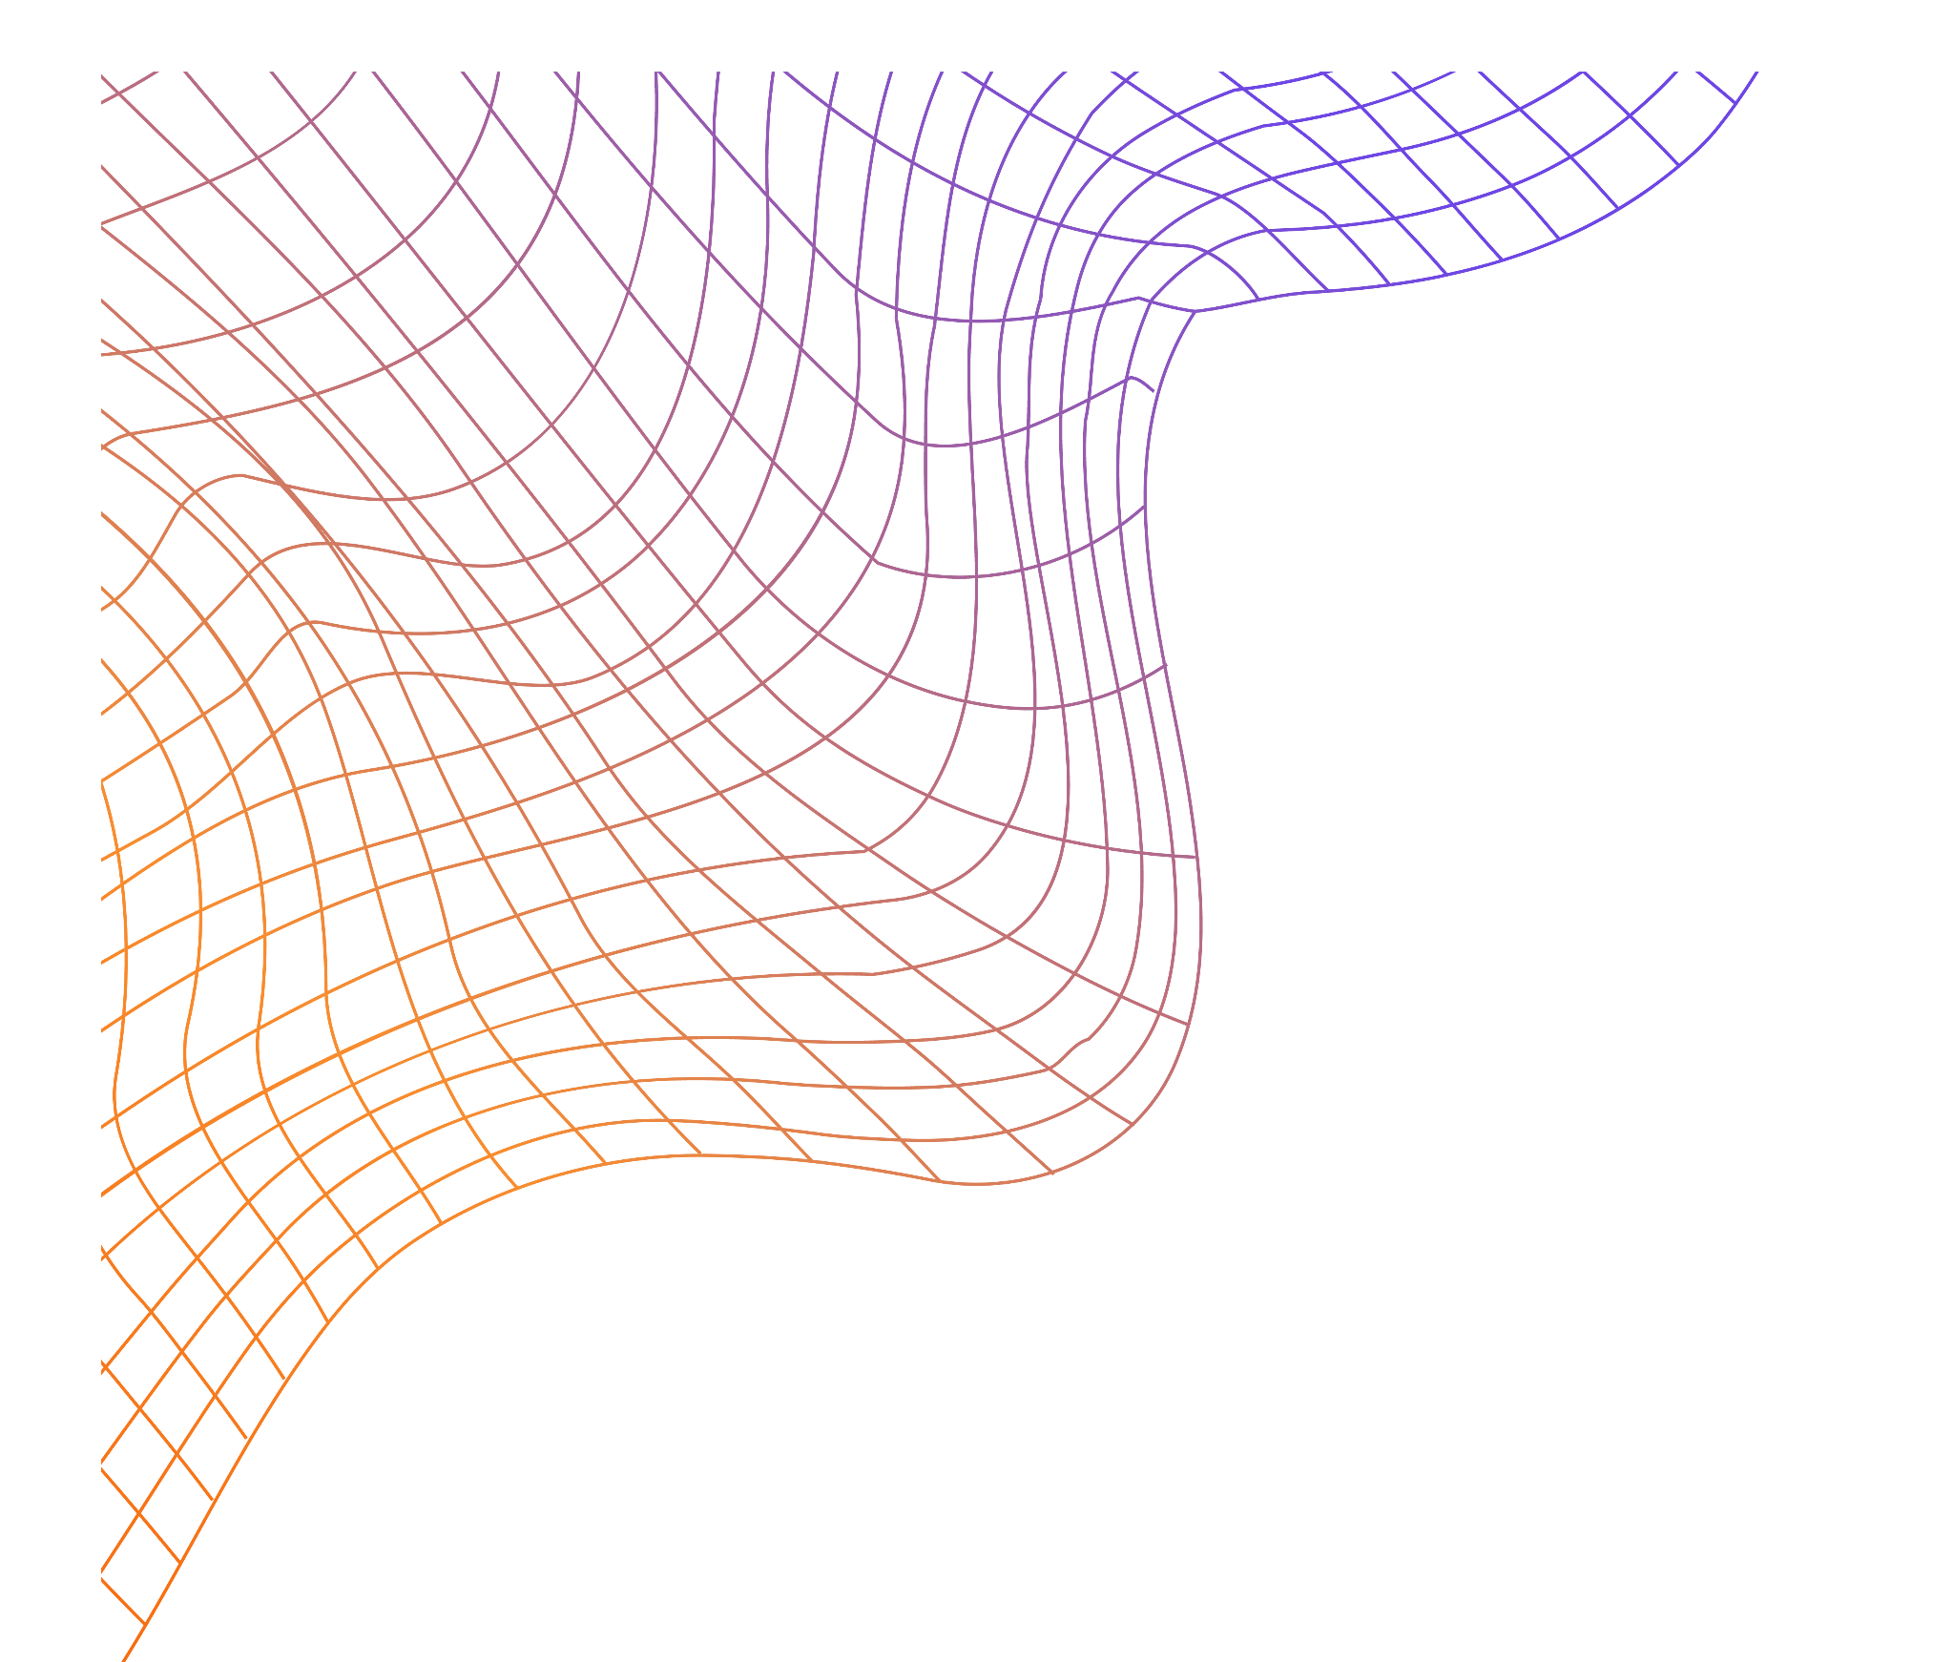
INVERTED PENDULUM RL
CA2 – DEEP LEARNING REINFORCEMENT LEARNING
Lim Zhen Yang 2214506 | Dario Prawara Teh 2201858
DAAA / FT / 2B / O4

Slide 2
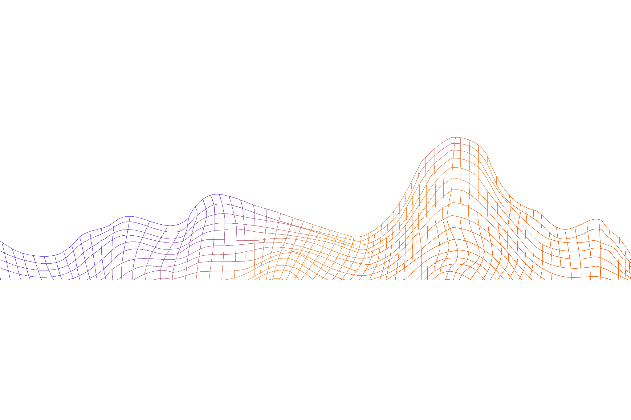
01.
Background Research

Slide 3
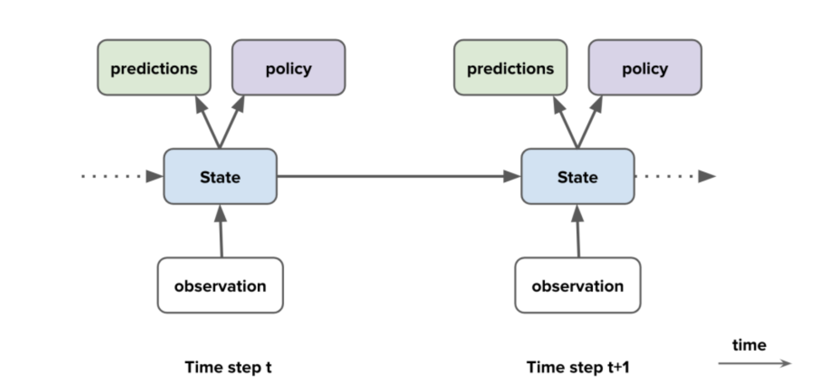
Introduction to reinforcement learning
Reinforcement Learning (RL) is a type of machine learning that focuses on training agents to make decisions in an environment by maximizing a reward signal.
Each of the algorithms revolve around an agent that plays in an environment. There are a few different types of components that an agent can contain.

Slide 4
Key Challenges
Delayed Reward
Exploration-Exploitation
Agents do not get immediate feedback on a per action basis. Rather, the reward system is attributed towards a sequence of actions. This means that agents must be considerate of the possibility that taking greedy approaches (essentially trying to retrieve immediate rewards) may result in less future reward.
The agent can continue to maximize the reward by repeatedly exploiting this specific knowledge OR Take actions that currently don't possess the maximum expected reward, to learn more about the environment and realize better options for the future.

Slide 5
02.
Exploratory Data Analysis

Slide 6

Nature of Task
The model must exert some appropriate torque on the pendulum to balance it.
Observation Space
X-coordinate
Y-coordinate
Angular velocity
Action space between –2.0 and 2.0

Slide 7

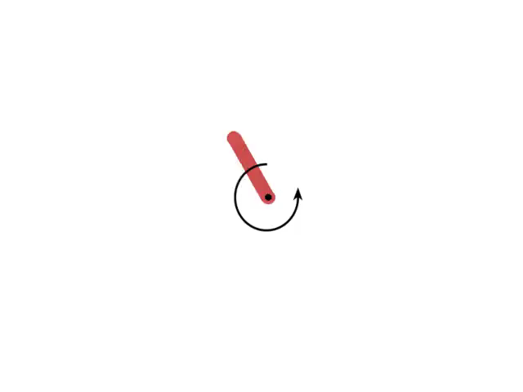
Testing actions and effects
Zero Torque
Positive Torque
The pendulum stabilizes in a downward position due to gravity
The positive torque helps the pendulum gain more angular momentum, but reduces stability of the pendulum around the upright position hence will result in lower rewards within the environment.

Slide 8
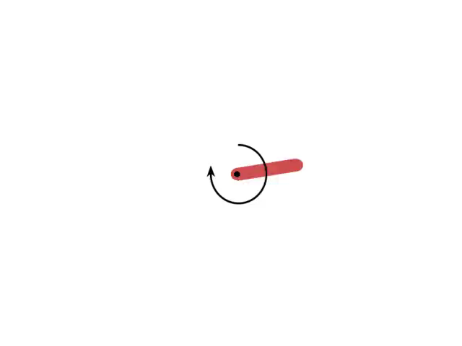
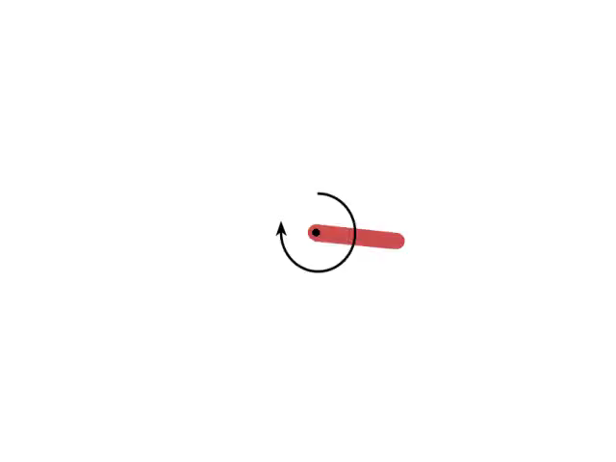
Testing actions and effects
Negative Torque
Gradual Increase In Torque
The negative torque helps the pendulum gain more angular momentum, but reduces stability of the pendulum around the upright position hence will result in lower rewards within the environment.
The gradual increase in torque leads to a systematic rise in the force applied to the pendulum. This incrementally alters the pendulum's behavior, potentially causing wider swings or movements in the opposite direction to its natural hanging position.

Slide 9
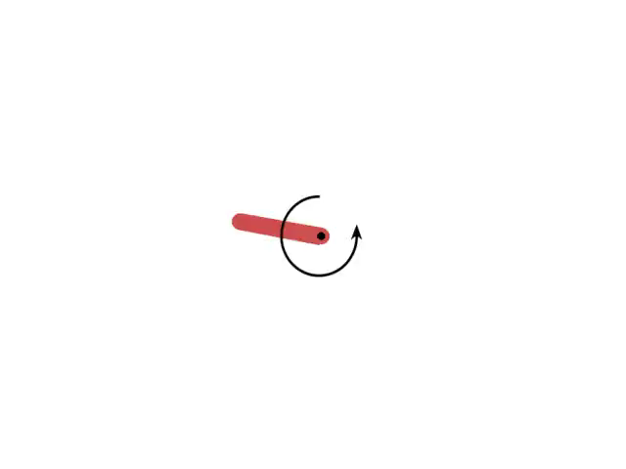
Testing actions and effects
Gradual Decrease In Torque
The gradual decrease in torque systematically reduces the applied force. This decrement may gradually slow down the pendulum's movement or bring it closer to the natural downward position, which could aid in stability but limit exploration for more optimal strategies.

Slide 10
03.
Model Building

Slide 11
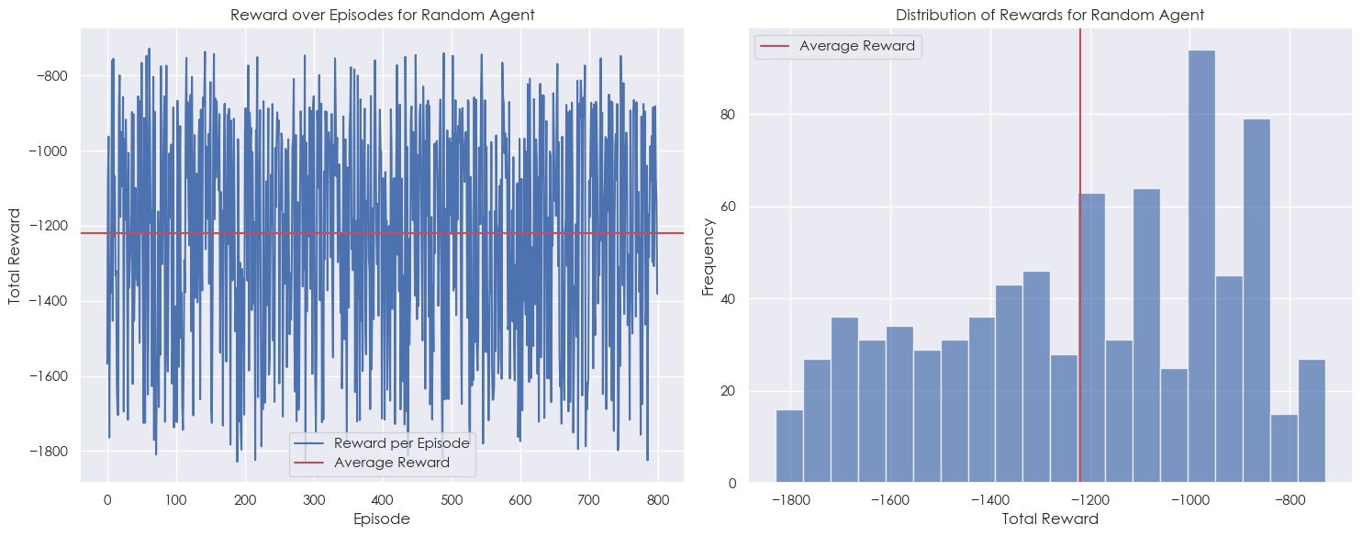
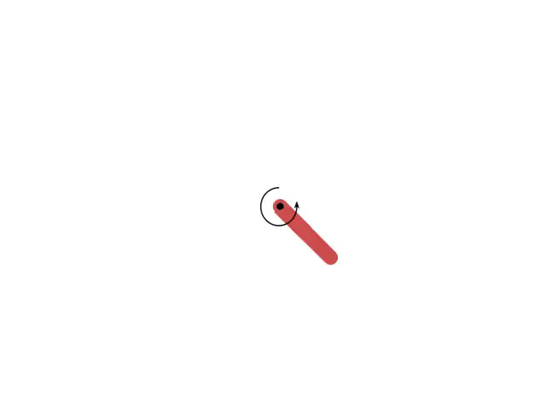
Baseline / Random action Model
This is a benchmark for us to evaluate our DQN models later.
No improvement in reward over episodes
Movements are made randomly
No learning involved

Slide 12
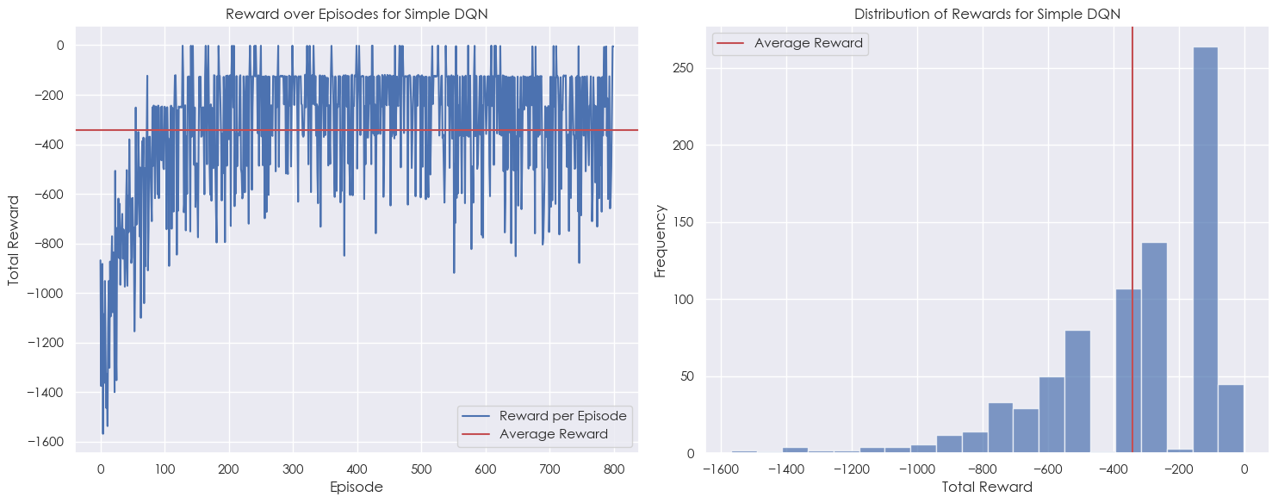

Simple Deep Q Network (DQN)
Agent performed significantly better than the baseline model
Indication of agent learning effectively from its experiences and is gradually refining its policy to better balance the pendulum upright vertically.

Slide 13
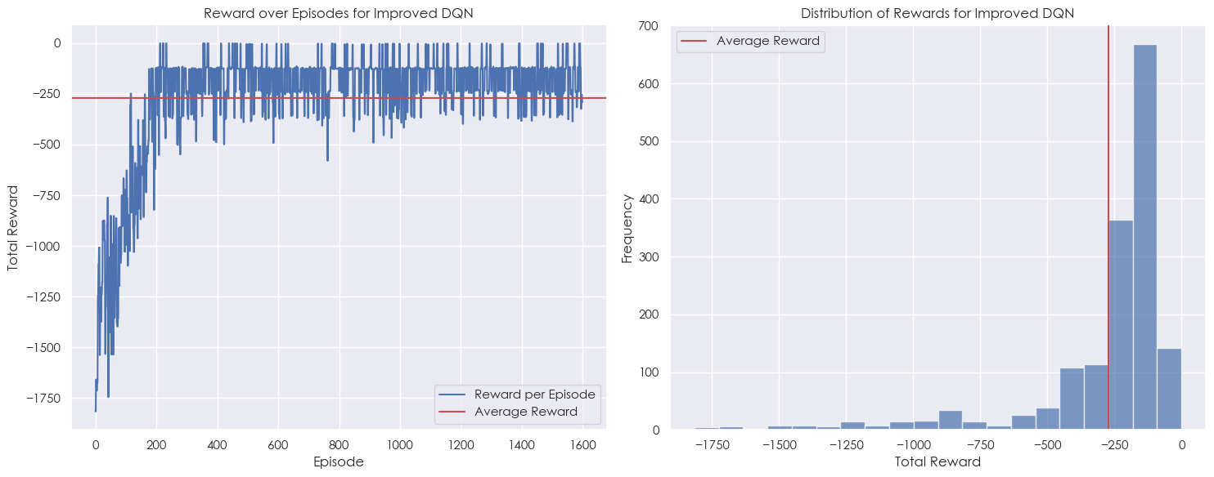

ENHANCED DQN MODEL (DQN)
We increased the number of actions the agent can perform and reduced learning rate
Average reward increased significantly
Agent reaches success faster and is more consistent

Slide 14
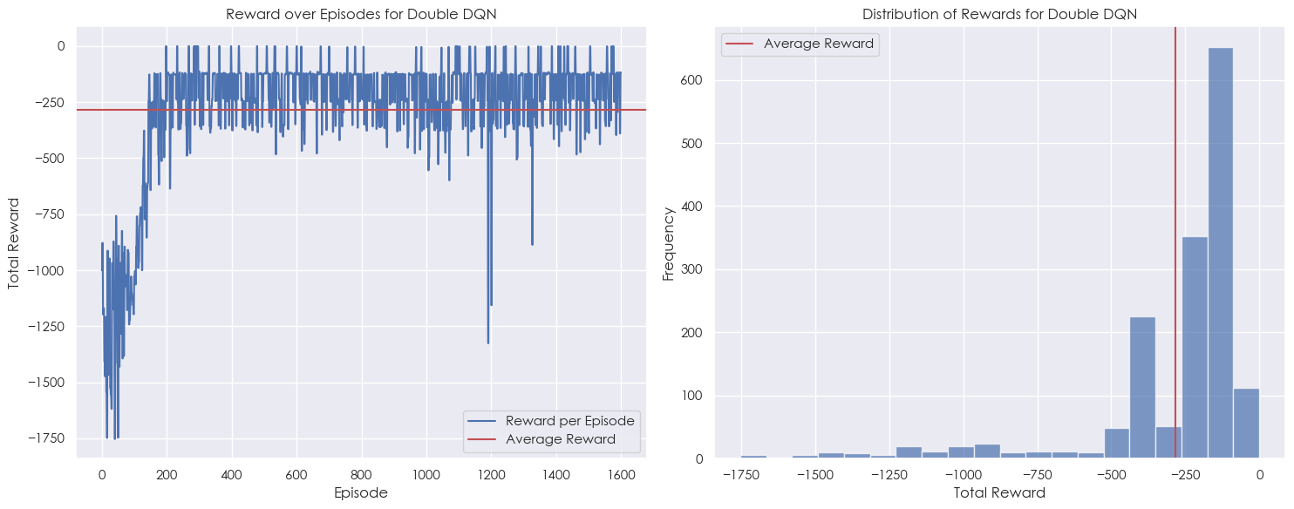

DOUBLE DEEP-Q NETWORK (DDQN)
DDQN utilizes two distinct neural networks. The first network, called the evaluation network. The second network, known as the target network, is used for evaluating the action's value.
There are no significant improvements that could be attributed to this simple environment

Slide 15
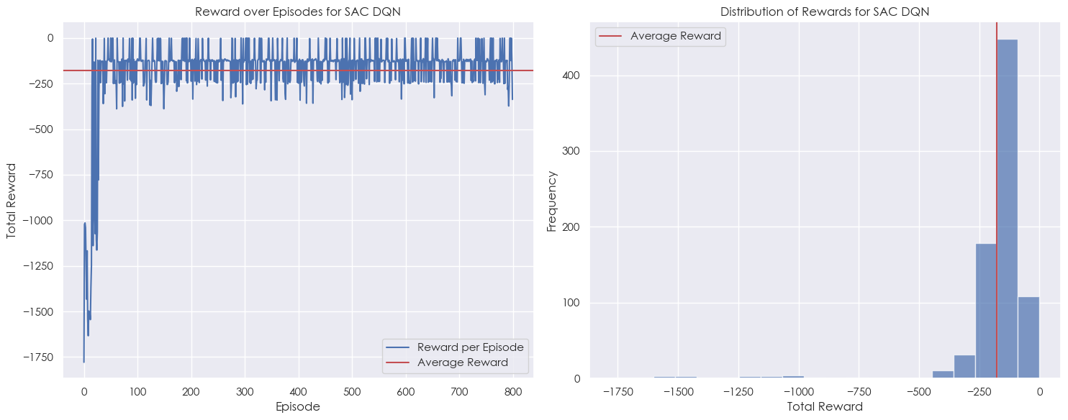

Soft Actor-Critic Network (SAC)
SAC works for continuous action tasks just like this one
Stochastic policy enables it to capture the inherent uncertainty in many real-world environments
Reached success faster
Consistently high rewards

Slide 16
04.
Model Evaluation

Slide 17
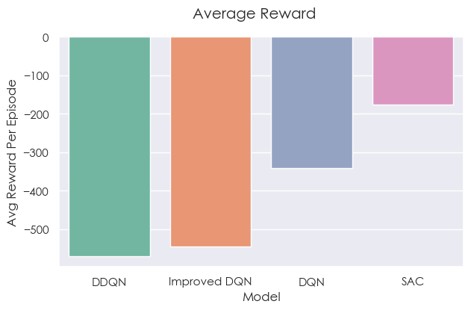
Average Reward Per Episode
SAC is way ahead in performance than the other models
It is consistently able to achieve high rewards

Slide 18
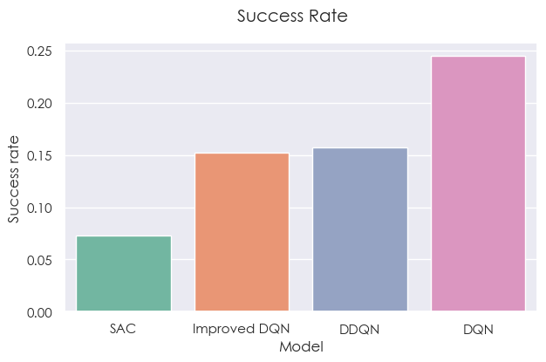
Success Rate
This metric calculates how well a model is able to improve from past experiences
DQN has the highest success rate because it whenever it performed badly, it was able to adjust itself
SAC had the lowest because it achieved stability and success way faster than the other models

Slide 19
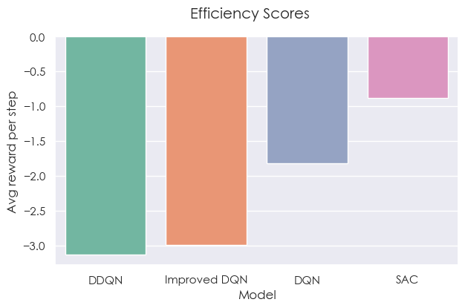
Efficiency Scores
Efficiency is calculated by total reward/total steps
Defined as the ability to achieve more with less
Not surprisingly, SAC had the highest efficiency score

Slide 20
Two Sample Independent t-test
To determine if the statistical difference between models are significant
H0: Average results are identical
H1: Average results are not identical
With a 95% confidence level, H0 is rejected for all models except DDQN and Enhanced DQN
Models | P-value (3s.f.) | H0 rejected?
DQN & Enhanced DQN | 1.89e-45 | Yes
DQN & DDQN | 4.46e-55 | Yes
DQN & SAC | 1.41e-40 | Yes
Improved DQN & DDQN | 0.095 | No
Improved DQN & SAC | 2.37e-152 | Yes
DDQN & SAC | 1.05e-166 | Yes

Slide 21
05.
Model Improvement

Slide 22
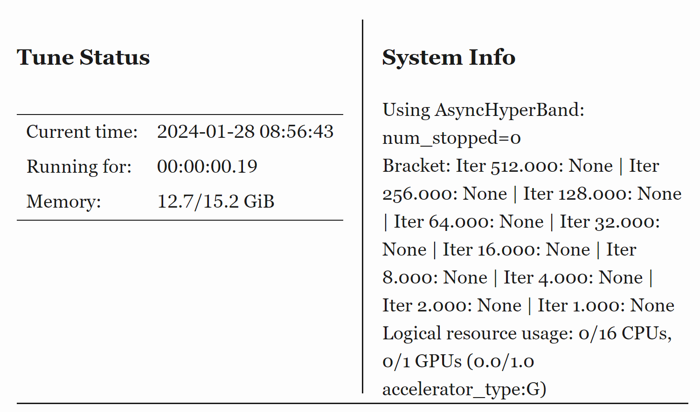
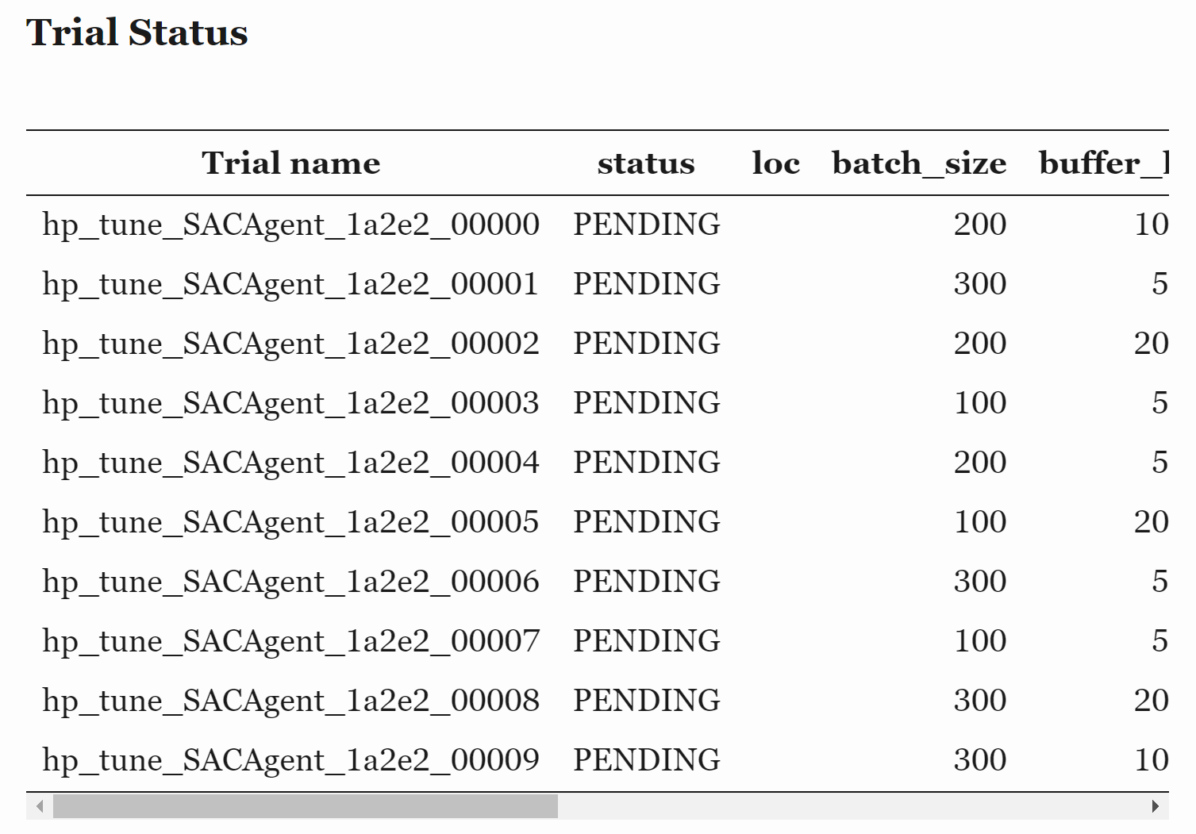
Hyperparameter tuning
Tuning SAC
Use of ASHAScheduler for efficient tuning
Ran 10 hyperparameter samples
Returns us the best configuration

Slide 23
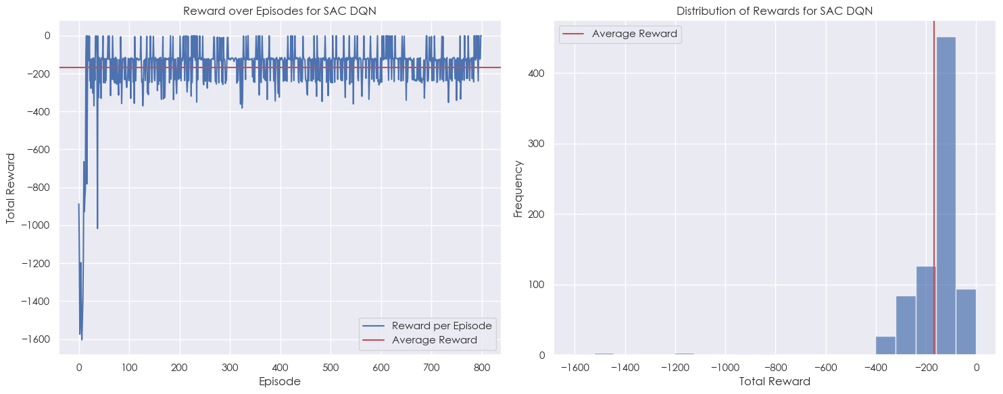
Comparing Results
Performance Statistics for the SAC Model:
--------------------------------------------
Best Episode : 657
Average Reward : -176.18
Median Reward : -126.34
Maximum Reward : -0.11
Minimum Reward : -1778.75
Performance Statistics for the Tuned SAC Model:
--------------------------------------------
Best Episode : 789
Average Reward : -168.98
Median Reward : -125.16
Maximum Reward : -0.24
Minimum Reward : -1604.26

Slide 24
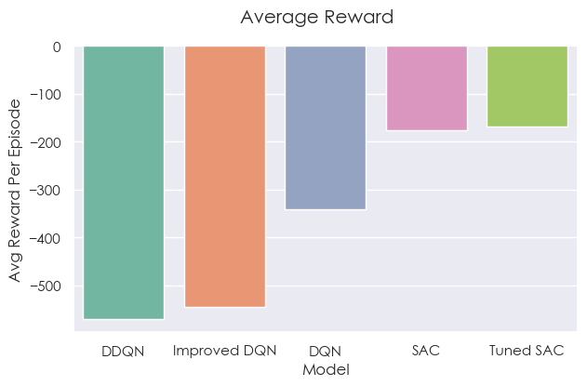
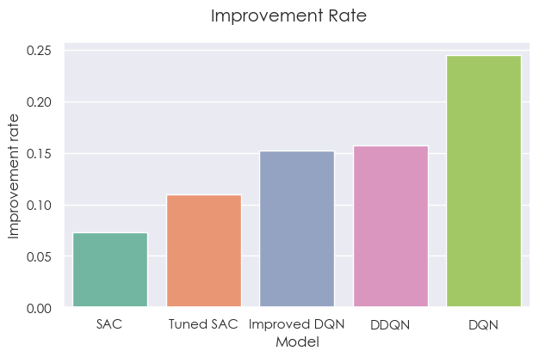
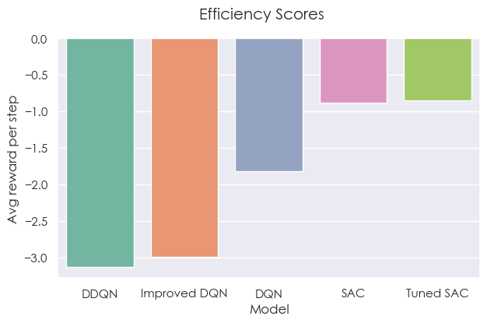
Hypertuned Evaluation
Tuned SAC achieved a higher average reward
Tuned SAC had a higher improvement rate than SAC
Tuned SAC was the most efficient model

Slide 25
Thank You

